Slide 1
Reproductive hormones

Slide 2
Endocrine glands secrete internally. They secrete directly into the bloodstream
Exocrine glands which have ducts and secrete externally, not into the bloodstream
Hormones: chemical agents which are carried by the blood to cells within a target organ or to other target cells where they regulate a specific physiological activity
Autocrine (affecting the cells that secrete it)
paracrine (affecting other cells in the same organ)
Endocrine its effect through circulatory system

Slide 3
Cells that respond to a specific hormone have receptor sites (recognition units) which bind that hormone
When a hormone binds to a receptor site, it initiates reactions within that cell
The concentration of receptor sites in a target organ will increase or decrease depending on the endocrine status of the animal

Slide 4
Chemically hormones of reproduction can be divided into two major classes:
First class includes the peptide and protein hormones
hormones are soluble in water (sensitive)
To be physiologically effective, they must be administered systemically (i.v., i.m., or s.c.)

Slide 5
Chemically hormones of reproduction can be divided into two major classes:
Second class are steroids
Steroids are a special class of lipids having cholesterol as a common precursor
They are not soluble in water but are soluble in many solvents

Slide 6
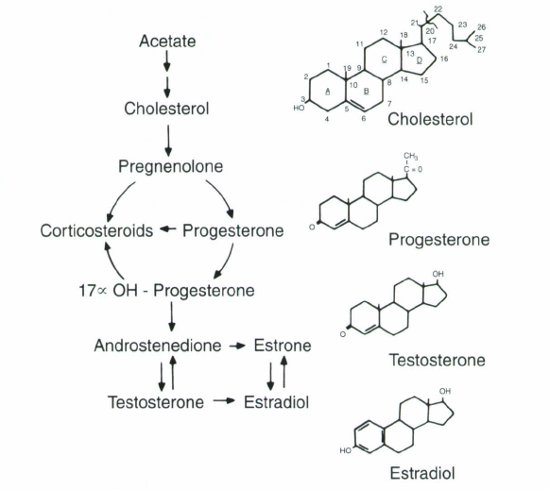

Slide 7
Functionally, hormones can be classified as
Primary hormones of reproduction directly regulate a reproductive activity
Secondary hormones of reproduction indirectly regulate a reproductive activity

Slide 8
Hypothalamus
Neuroendocrine gland that forms along the floor and lateral wall of the third ventricle of the brain
The hypophyseal portal blood system connects the hypothalamus with the anterior pituitary The posterior pituitary is an extension of the hypothalamus
Axons from neurosecretory cells in the hypothalamus extend down into the posterior pituitary

Slide 9
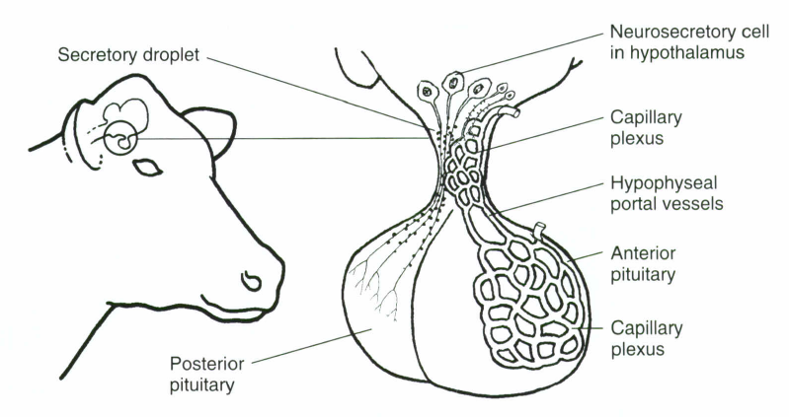

Slide 10
HORMONES OF HYPOTHALMUS
Gonadotropin-releasing hormone (GnRH)
FSH and LH
Prolactin-releasing factor (PRF)
Prolactin-inhibiting factor (PIF)
control the release and retention of prolactin in the anterior pituitary
Corticotropin-releasing hormone (CRH)
stimulates the release of ACTH
Growth hormone-releasing hormone (GHRH)
stimulates the release of growth hormone (GH)
Thyrotropin releasing hormone (TRH)
stimulates the release of thyroid stimulating hormone (TSH)

Slide 11
Pituitary gland
Anterior pituitary
Follicle stimulating hormone (FSH)
Luteinizing hormone (LH)
Prolactin
Adrenocorticotropin (ACTH)
Thyroid stimulating hormone (TSH)
Growth hormone

Slide 12
Pituitary gland
posterior pituitary
Oxytocin

Slide 13
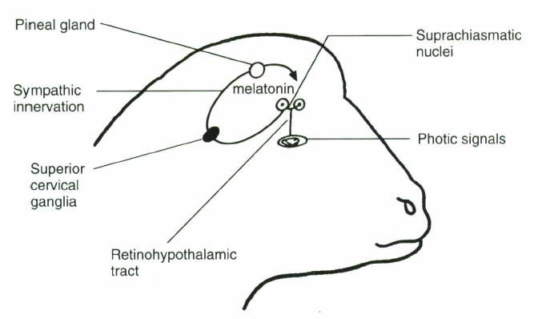
Pineal Gland
located posterior to the hypothalamus

Slide 14
HORMONES OF THE GONADS
Estrogen
Steroid hormone
Graafian follicle (theca cells under effect of FSH)
Estradiol, Estrone, Estriol
(I) the manifestation of mating behavior during estrus
(2) cyclic changes in the female tract
(3) duct development in the mammary gland
(4) development of secondary sex characteristics in females
(5) regulate FSH and LH secretion

Slide 15
HORMONES OF THE GONADS
Progestins
Steroid hormone
Corpus luteum or placenta (granulose cells under effect of LH)
Progesterone, 17-Hydroxy-progesterone, 20-B-dihydroprogesterone
(I) the manifestation of mating behavior during estrus
(2) cyclic changes in the female tract
(3) duct development in the mammary gland
(4) development of secondary sex characteristics in females
(5) regulate FSH and LH secretion

Slide 16
HORMONES OF THE GONADS
Testosterone
Steroid hormone
Testis (Leydig cells under effect of LH)
Testosterone, Androstenedione, Dihydrotestosterone

Slide 17
HORMONES OF THE GONADS
Inhibin (protein hormone) from granulosa cells
Activin (protein hormone) from granulosa cells
Relaxin polypeptide hormone from corpus luteum as well as placenta
Oxytocin peptide hormone from corpus luteum

Slide 18
HORMONES OF THE ADRENAL CORTEX
The adrenal cortex produces two classes of steroid hormones that have been associated with
mineral metabolism (mineralocorticoids)
carbohydrate metabolism (glucocorticoids)
progestins, estrogens, and androgens
Cortisone and cortisol
Play role for parturition
Has effect indirectly on reproduction

Slide 19
HORMONES OF PLACENTA
The placenta and does not fit the classical definition of an endocrine gland but does assume an endocrine function during pregnancy
1- Estrogens, progestins and relaxin
2- Human chorionic gonadotropin (hCG)
3- Pregnant mare serum gonadotropin (PMSG), which is sometimes called equine chorionic gonadotropin (eCG)

Slide 20
HORMONES OF UTERUS
Prostaglandins F2 alpha
Unsaturated fatty acid
Many types of prostaglandins

Slide 21
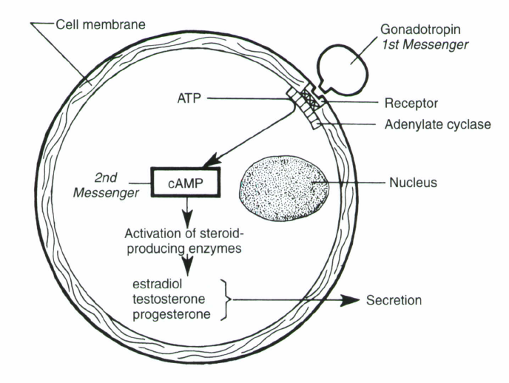
REGULATION OF HORMONAL RECEPTOR SITES

Slide 22
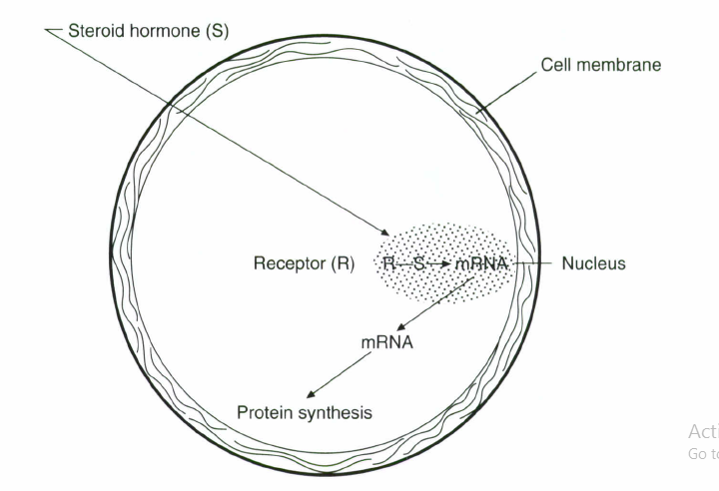
REGULATION OF HORMONAL RECEPTOR SITES

Slide 23
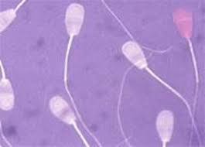
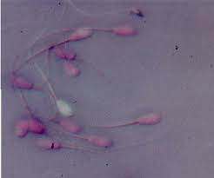
Determination the percentage of dead and live sperm
Determine the quality of semen
The acceptable ratio for dead sperm not more than 20%
There are many methods to determine this ratio:
A special stain (the dead sperms absorb the stain due to the permeabilization of its membrane not like live sperm)

Slide 24
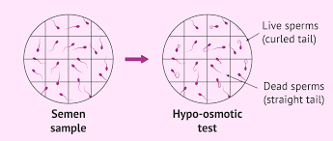
Determination the percentage of dead and live sperm
The use of hypotonic solution

Slide 25
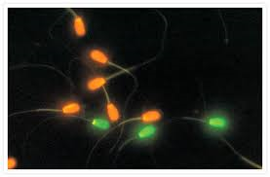
Determination the percentage of dead and live sperm
The use of florescent satin

Slide 26
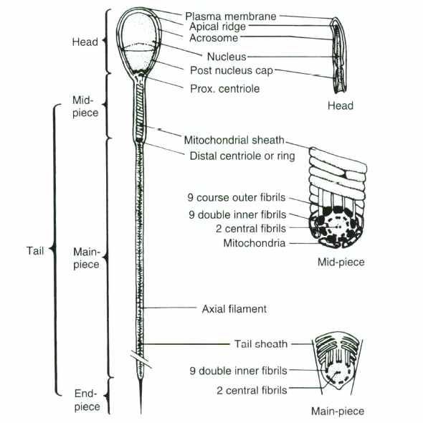
Sperm morphology

Slide 27
Sperm morphology
Sperm abnormalities ( 4-10%) and not more than 10%
Primary abnormalities (occur during spermatogenesis)
Genetics
Diseases
Environmental factors
Nutritional factor
Increasing in testis temperature
Interfere with fertilization capacity
It include : pyriform head, tapering head, narrow head, micro head, broken mid piece, enlarged mid piece, double head

Slide 28
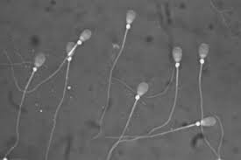
Sperm morphology
Sperm abnormalities
Secondary abnormalities (occur outside testis especially during storage inside epididymis or ampulla)
Problems in nutrition
Interfere with fertilization capacity
It include : cytoplasmic droplets

Slide 29
Sperm morphology
Sperm abnormalities
Tertiary abnormalities (occur during prepare slide or cold shock or osmotic shock (bent tail) or detach acrosome
Doesn’t reflect the ability of sperm for fertilization
Include broken head, broken tail

Slide 30
Sperm concentration
Determine the fertility of male
Determine the suitable concentrations of diluters or extender
The effect of season
The are many methods for this purpose:
Direct sperm count
Spectrophotometer
Electronic Particle Counter

Slide 31
Sperm concentration
Direct sperm count
Hemocytometer
Sperm dilution (1:200) (normal saline 0.9 NaCl)
HgCl ( kill sperms to stop any movement)
Ordinary method for counting like RBC counting
Use 25 square ( if you used 5 squares should be X 5)
No. sperm/ml = no. sperm in 0.1 mm³ X 10 X dilution rate X 1,000

Slide 32
Sperm concentration
Spectrophotometer (depending on Light transmittance)
Calculate the intensity of light which reflected from the sample
Electronic Particle Counter
The instrument can be adjusted for particle size so that only the sperm cells in a sample will be counted

Slide 33
Biochemical and biological evaluation
This type of evaluation depend on the measuring the activity rate of the sperms after ejaculation especially the metabolism of sperms
This evaluation include:
Oxygen take-up
Fructolysis index
PH
Methylene blue reduction test

Slide 34
Biochemical and biological evaluation
Oxygen take-up
The amount of oxygen which are consumed by 100 million sperms per minute
Especial instrument calculate that (microspirometer, Bercroft)
If this ratio increase so the sample is ????

Slide 35
Biochemical and biological evaluation
Fructolysis index
The consuming of fructose is deal with the activity of sperms
Determine directly after ejaculation
After that incubate in 37 C for 1 hour
Determine the amount of fructose which consumed
The index for 1000 million sperms
The normal value 1.4-2 mg/ hr

Slide 36
Biochemical and biological evaluation
PH
Any changing in PH is mean the activity of sperms and formation of lactic acid under oxygenated condition
After ejaculation the amount of lactic acid is 63mg/cm3 which lead to form PH 6.6-6.9
After a time of incubation the PH will be decrease as a result of lactic acid formation

Slide 37
Biochemical and biological evaluation
Methylene blue reduction test
Reduction time depending on quality of semen
The releasing of H ions from sperms reduce the stain from blue to colorless
Good quality semen reduce the stain after 3-6 min.
Poor quality semen reduce the stain after 9 min.

Slide 38
Semen Diluters
(Semen Extender)

Slide 39
Properties of semen extender
isotonic with semen like
2.9% sodium citrate di-hydrate
0.2 molar Tris solution
2. Buffering capacity like isotonic sodium citrate or tris solution or milk
Phosphate Buffer Solution
Citrate Buffer Solution
Tris Buffer Solution
Milk

Slide 40
Properties of semen extender
3. Protect the sperm from cold shock injury during the cooling from body temperature to 5°C
lecithin
Lipoproteins
(from egg yolk or milk)

Slide 41
Properties of semen extender
4. Nutrients must be provided for sperm metabolism
(egg yolk, milk, and some simple sugars)
5. Antibiotics
500 µg Gentamicin
100 µg Tylosin
300/600 µg Linco-Spectin
(300 µg Lincomycin and 600 µg Spectinomycin)

Slide 42
Properties of semen extender
6. Protection from injury during freezing and thawing
Glycerol
DMSO
7. The diluter must preserve the life of the sperm with a minimum drop in fertility combination of known and unknown factors.

Slide 43
Effective Diluters
1- Yolk-Phosphate (phosphate buffer solution and fresh egg yolk) the ratio 1:3
2- Yolk-Citrate (fresh egg yolk and citrate buffer solution) the ratio 1:1
3- Yolk-Tris the ratio 1:5
4- Homogenized Milk and Skim Milk (heating the milk to 90°C to 95°C for 10 minutes to inactivates lactenin)

Slide 44
Dilution rate:
the total number of sperms in the ejaculate / 10-15 million = number of inseminate
each one inseminate need 0.5 ml diluter

Slide 45
Diluter preparation
The total quantity divided into two equal parts
- part A add 500 µg Gentamicin, 100 µg Tylosin, 300/600 µg Linco-Spectin
part B add 14% glycerol
Both parts should be cooled and stored at 5°C until the day of collection
Semen collect from the animal and store in water bath in (35°C)

Slide 46
Dilution
-Predilution of the warm semen (35°C) with warm part A (35°C) diluter in water bath (1-2 hrs)
Cooling by placing the prediluted 35°C semen container in a container of water in refrigerator and cooled to 5°C (45-60 min.)
Add part B (5°C) diluter to the mixture in 2 steps (between them 15 min.) and leave it for 3-4 hrs. in 5°C (equilibration period)

Slide 47
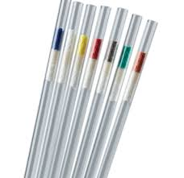
Packaging
Glass ampules with 0.5-ml
plastic straw with 0.5-ml
In 5°C
During equilibration period

Slide 48
Freezing
Two steps for freezing
Above the nitrogen (5.5 cm) through nitrogen vapors to reach -80°C for 10 min.
Storage in liquid nitrogen in - 196°C

Slide 49
ENERGY METABOLISM BY SPERMATOZOA

Slide 50
Energy metabolism is the means by which spermatozoa convert energy substrates into usable forms of energy
Enzymes of mitochondria responsible for this metabolism
Fructose, sorbitol, and GPC which are present in seminal plasma
Plasmalogen, a lipid found within the spermatozoa is an energy reserve that can be used when other substrates are limiting
Adenosine triphosphate (ATP), a high-energy compound, is the form of energy that can be used by spermatozoa

Slide 51
ATP + H20 ADP + H3P04 + 7,000 calories/mole
Fructose 2 lactic acid + 2 ATP (an aerobically)
Fructose CO2 + H20 + 38 ATP (aerobically)

Slide 52
Factor affecting on sperm metabolism
Temperature
PH
Osmotic pressure
Sperm concentration
Hormones
Gases
Light
Antimicrobial agents

